Slide 1
Designing an Object Detection System
Group 4

Slide 2
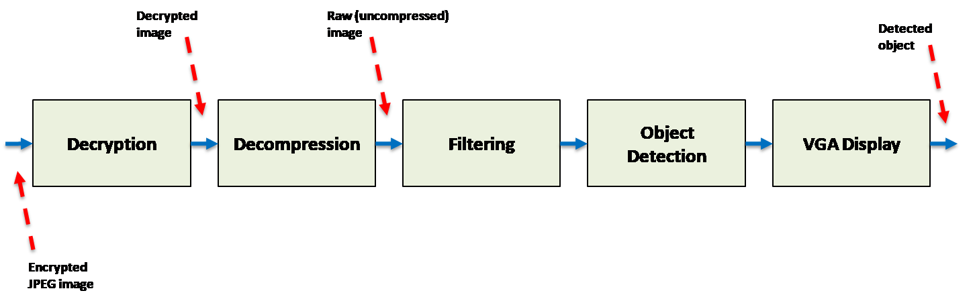
Introduction

Slide 3
ID Tags

Slide 4
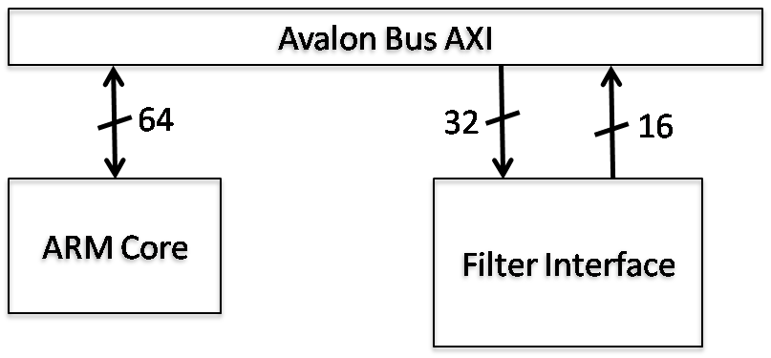
Filtering

Slide 5
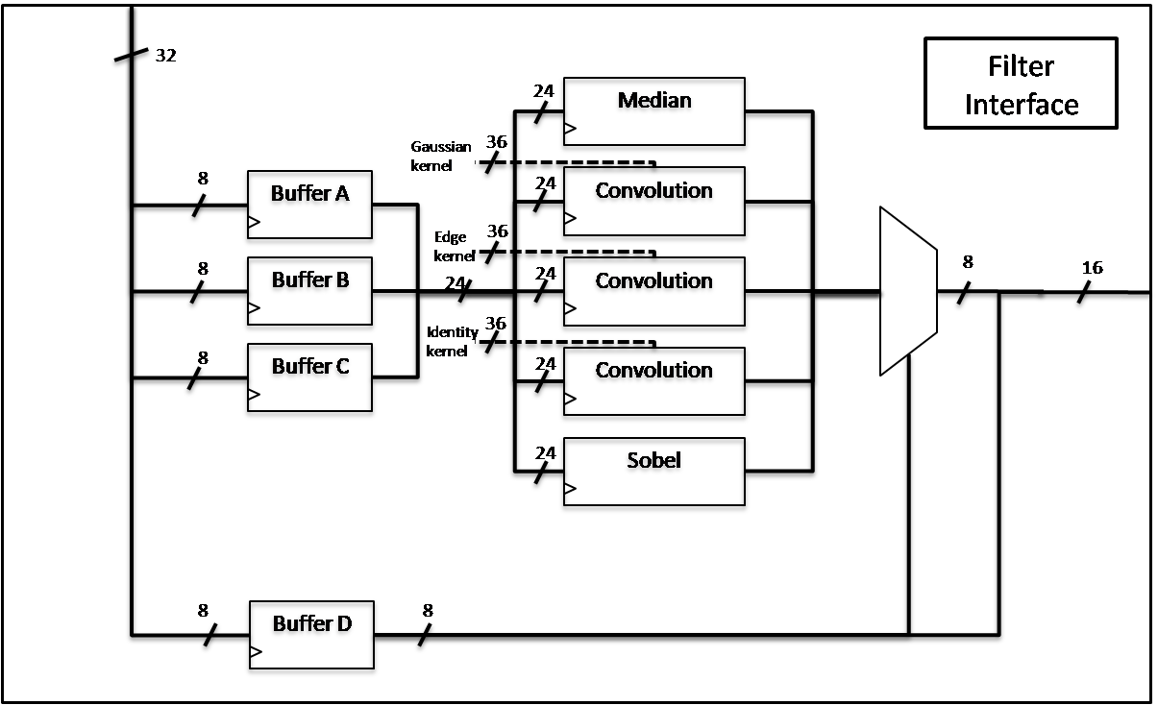
Hardware Pipelining

Slide 6
Object Detection

Slide 7
OpenCV filtering

Slide 8
VGA Cache Access
Changed from columns to row
Improved by 13.82%

Slide 9
Future Work
Daisy chaining
Dual-core

Slide 10
Discussion

Slide 11
Performance Improvements
*I need numbers here*
Compare baseline solution with final solution

Slide 12
Final Solution

